Slide 1
Features extraction from text

Slide 2


Text feature extraction
Feature extraction is transforming arbitrary data, such as text or images, into numerical features usable for machine learning.
The latter is a machine learning technique applied on these features.

Slide 3
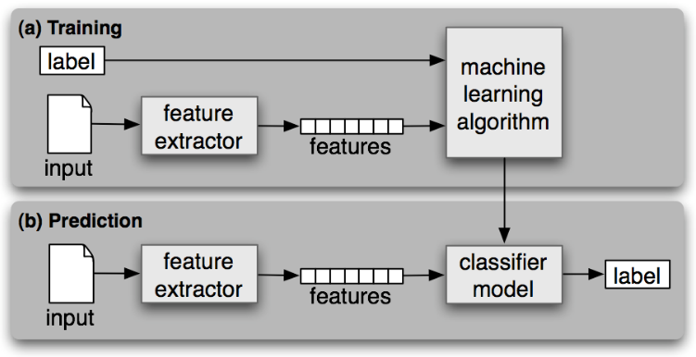
Why extract features from text?

Slide 4
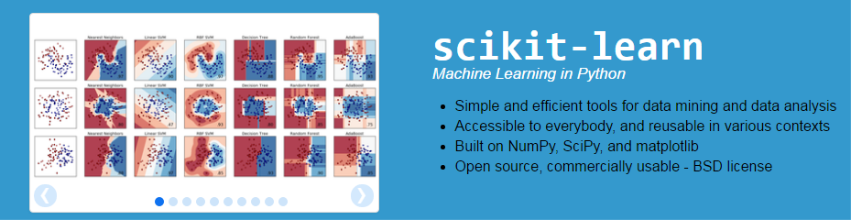

Libraries

Slide 5
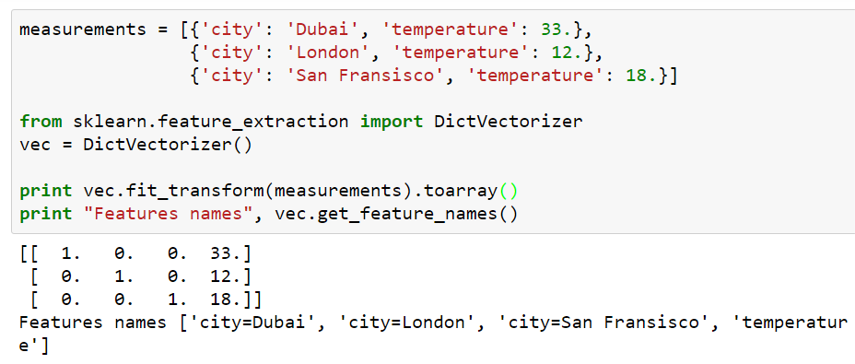
Loading features from dicts
DictVectorizer implements what is called one-of-K or “one-hot” coding for categorical (aka nominal, discrete) features.

Slide 6
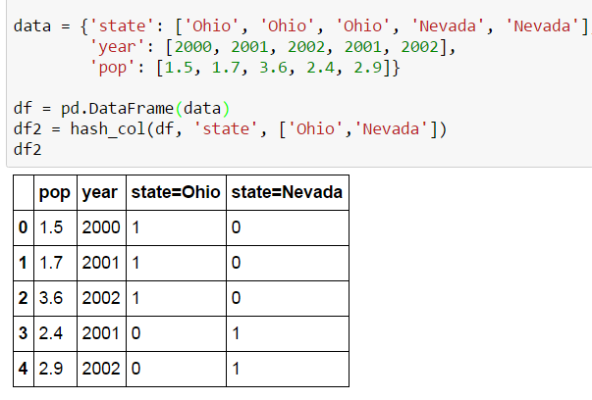
Feature hashing
FeatureHasher apply a hash function to the features to determine their column index in sample matrices directly.

Slide 7
The Bag of Words representation
Bag of Words is specific strategy for features extraction, which includes:
tokenizing strings and giving an integer id for each possible token, for instance by using white-spaces and punctuation as token separators.
counting the occurrences of tokens in each document.
normalizing and weighting with diminishing importance tokens that occur in the majority of samples / documents.

Slide 8
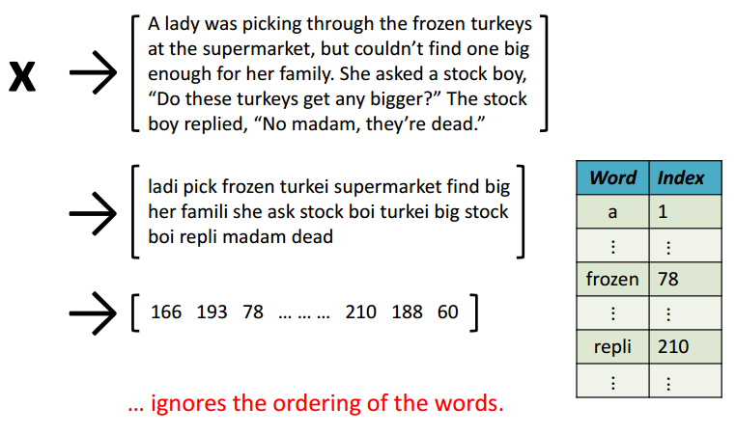
The Bag of Words representation for documents

Slide 9
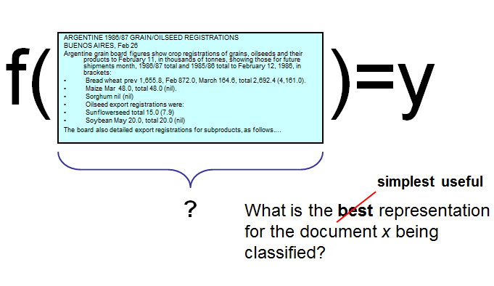
Bag of Words

Slide 10
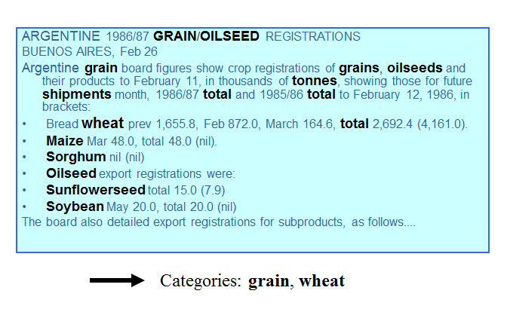
Bag of Words

Slide 11
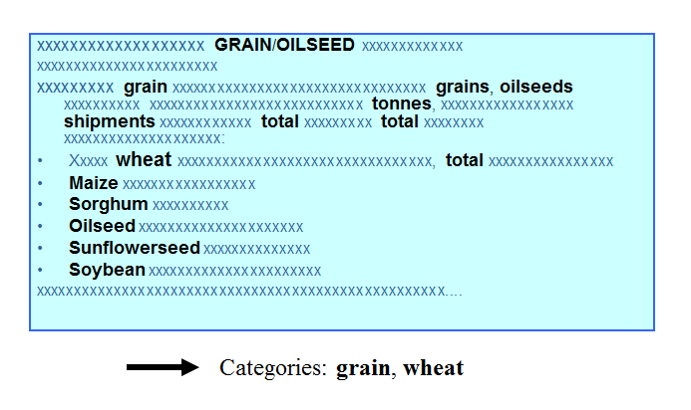
Bag of Words

Slide 12
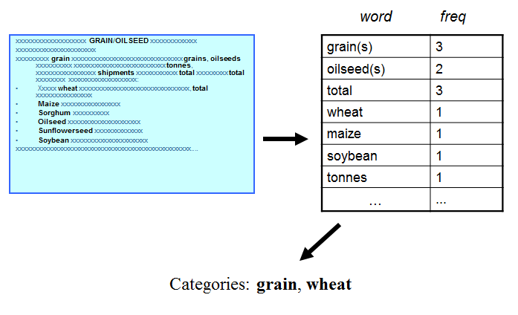
Bag of Words

Slide 13
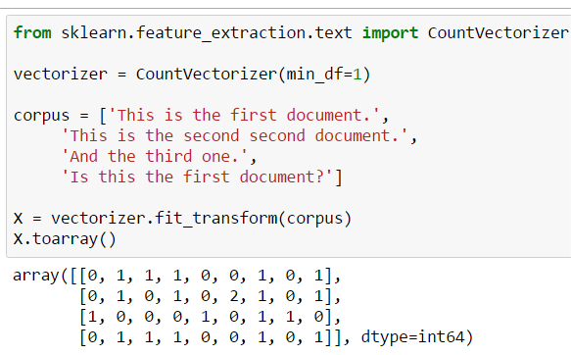
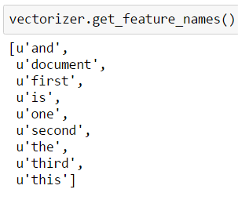
Common Vectorizer usage
CountVectorizer implements both tokenization and occurrence counting in a single class

Slide 14
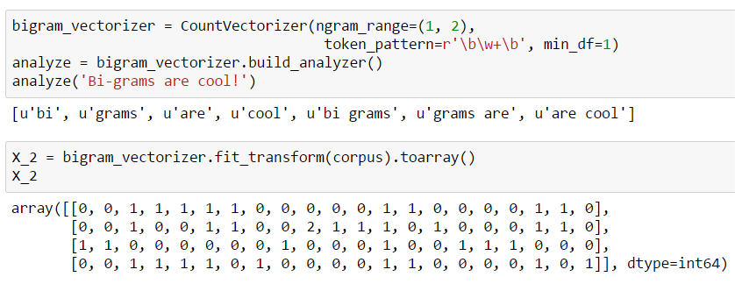
Vectorizer: n-grams
To preserve some of the local ordering information we can extract 2-grams of words in addition to the 1-grams (individual words)

Slide 15
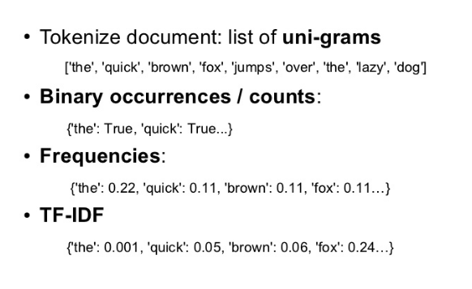
TF-IDF
In order to re-weight the count features into floating point values suitable for usage by a classifier it is very common to use the tf–idf transform

Slide 16
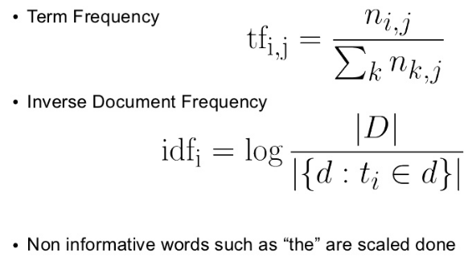
TF-IDF

Slide 17
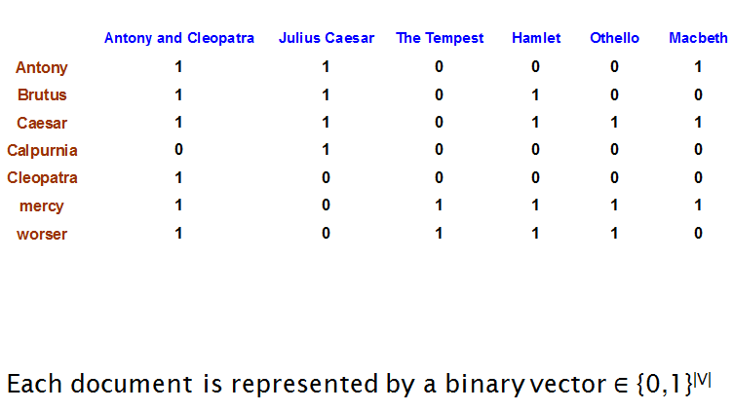
Binary term-document incidence matrix

Slide 18
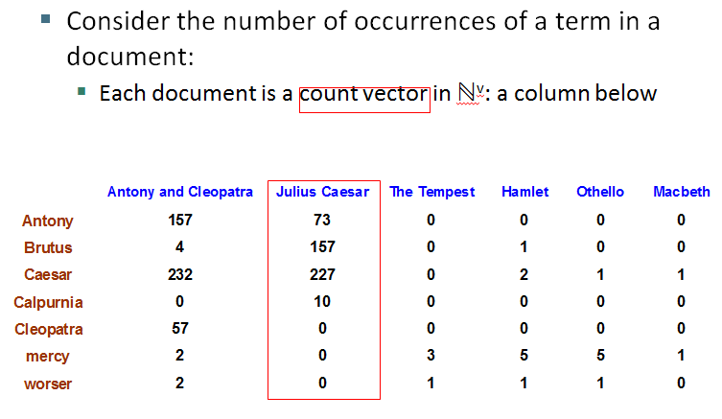
Term-document count matrices

Slide 19
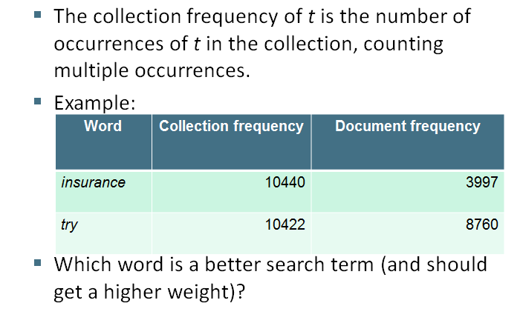
Document frequency

Slide 20
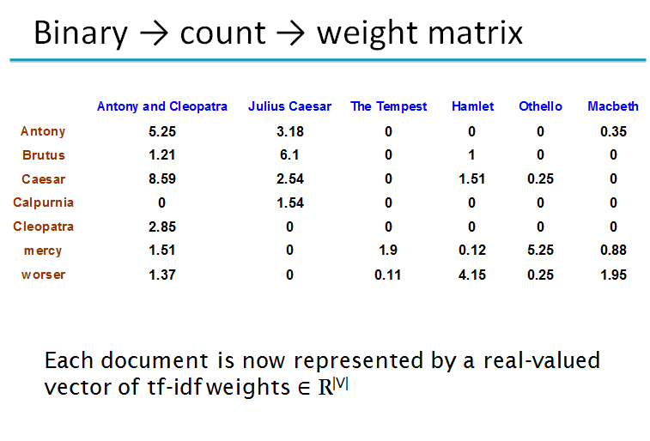
Document frequency

Slide 21
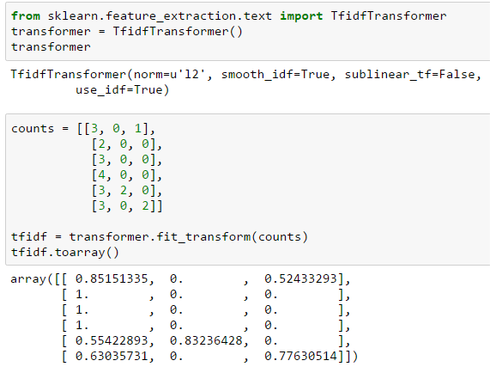
TF-IDF

Slide 22
Distances between texts sets

Slide 23
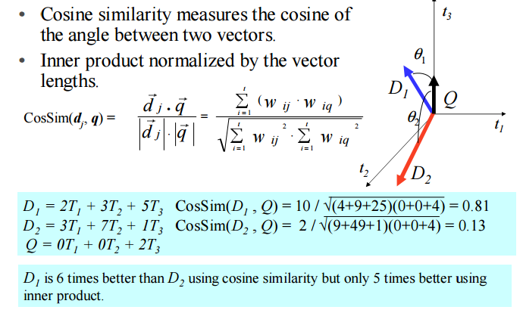
Cosine Similarity Measure

Slide 24
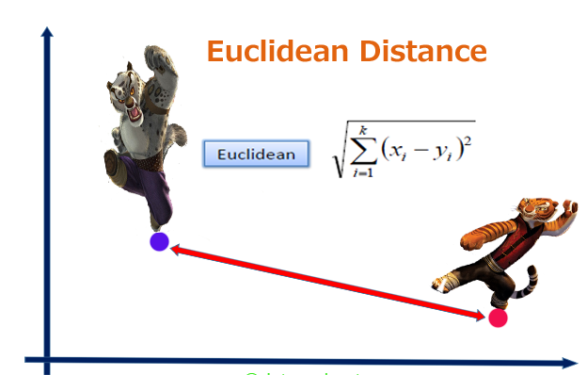
Euclidean Distance

Slide 25
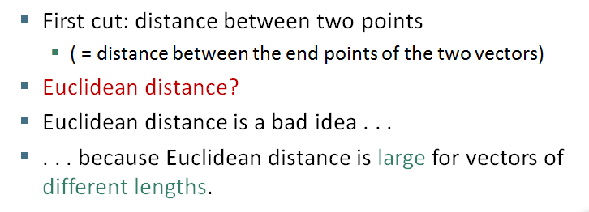
Euclidean Distance

Slide 26
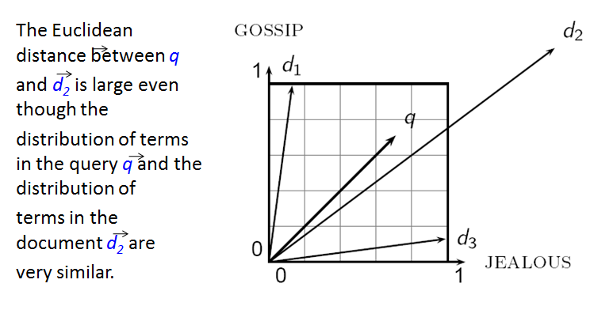
Why distance is a bad idea?

Slide 27
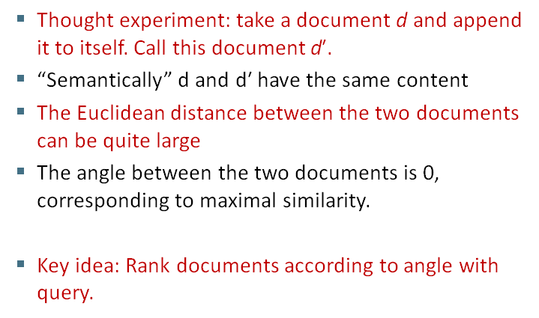
Use angle instead of distance

Slide 28
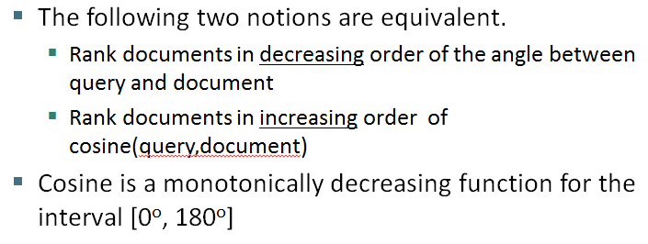
From angles to cosines

Slide 29
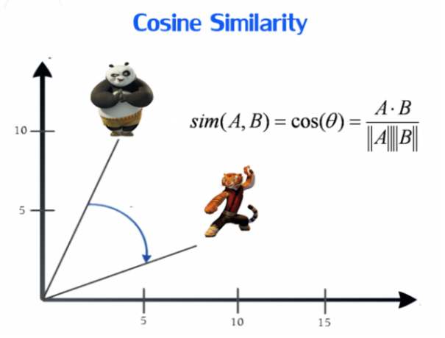
From angles to cosines

Slide 30
From angles to cosines

Slide 31
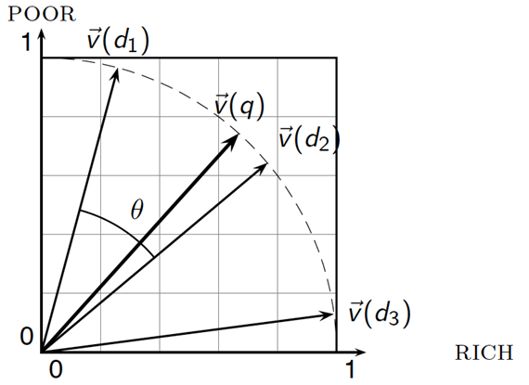
Cosine similarity illustrated

Slide 32
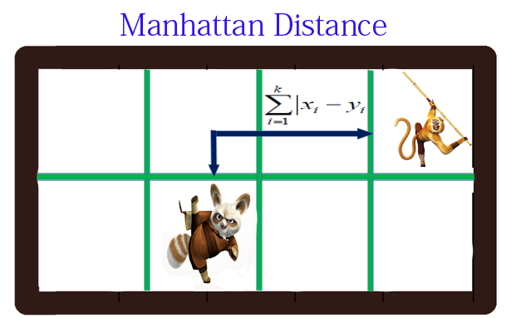
Manhattan distance is an metric in which the distance between two points is the sum of the absolute differences of their Cartesian coordinates.

Slide 33
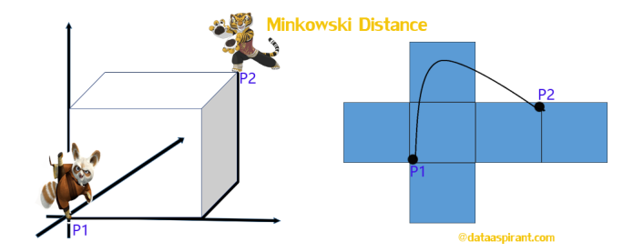
The Minkowski distance is a generalized metric form of Euclidean distance and Manhattan distance.

Slide 34
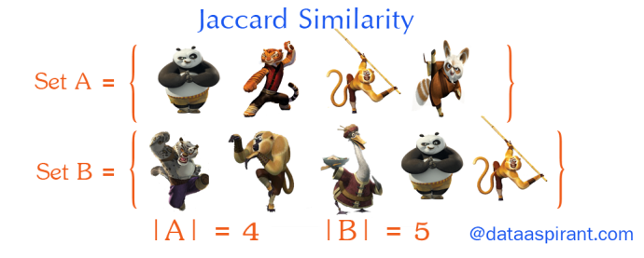

Slide 35

The Jaccard similarity measures similarity between finite sample sets, and is defined as the cardinality of the intersection of sets divided by the cardinality of the union of the sample sets. Suppose you want to find jaccard similarity between two sets A and B it is the ration of cardinality of A ∩ B and A ∪ B.

Slide 36
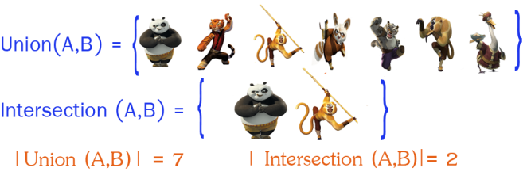
Sets:A set is (unordered) collection of objects {a,b,c}. we use the notation as elements separated by commas inside curly brackets { }. They are unordered so {a,b} = {b,a}.
Cardinality:The Cardinality of A (denoted by |A|) counts how many elements are in A.
Intersection:Intersection between two sets A and B is denoted A ∩ B and reveals all items which are in both sets A,B.
Union:Union between two sets A and B is denoted A ∪ B and reveals all items which are in either set.

Slide 37
Thank you!

